Slide 1
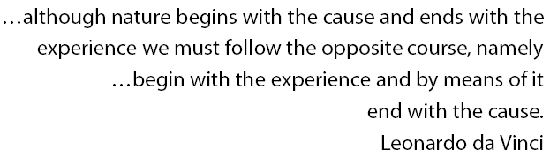




INVERSE PROBLEMS and REGULARIZATION THEORY – Part I
AIP 2011
Texas A&M University
MAY 21, 2011
CHUCK GROETSCH

Slide 2
OUTLINE
What are I.P.s? - Some History
Some Model I.P.s
A Framework for I.P.s
Key Issue: Well-posedness
The Moore-Penrose Inverse
Compact Operators and the SVD
What is ‘Regularization’?

Slide 3
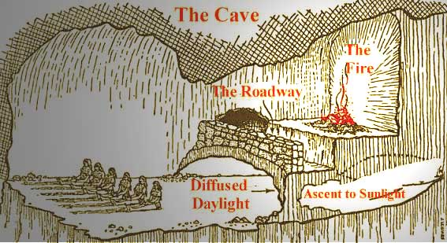
WHAT ARE INVERSE PROBLEMS?
PLATO’S CAVE

Slide 4
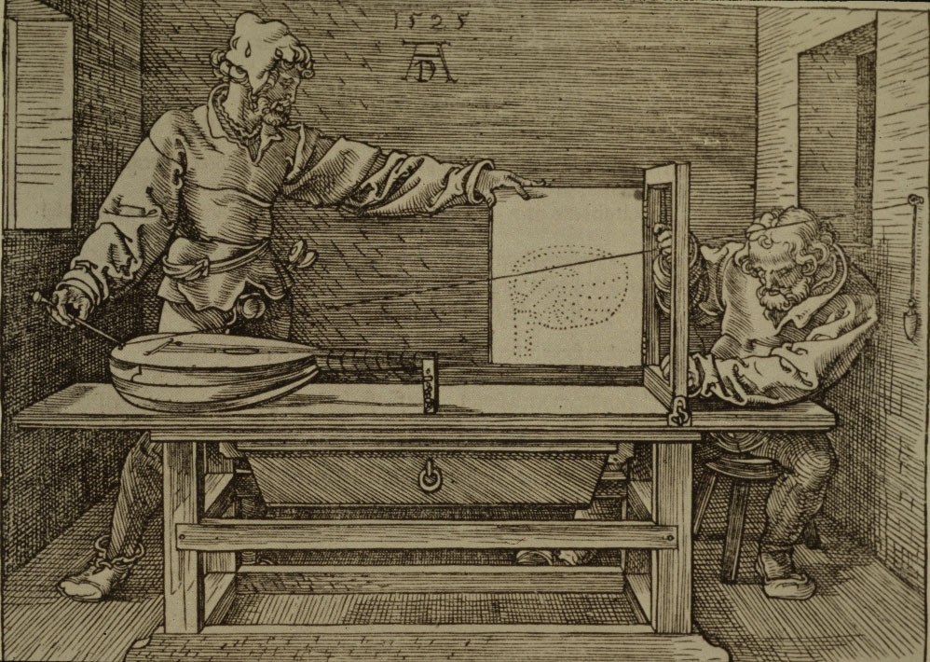
Dürer: Man drawing a lute
A Renaissance Inverse Problem

Slide 5
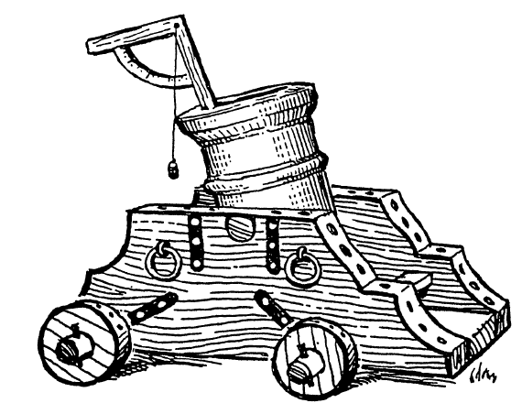
Renaissance Ballistics
I knew that a cannon could strike in the same place with two different elevations or aimings, I found a way of bringing this about, a thing not heard of and not thought by any other, ancient or modern.
Nicolò Tartaglia, 1537

Slide 6
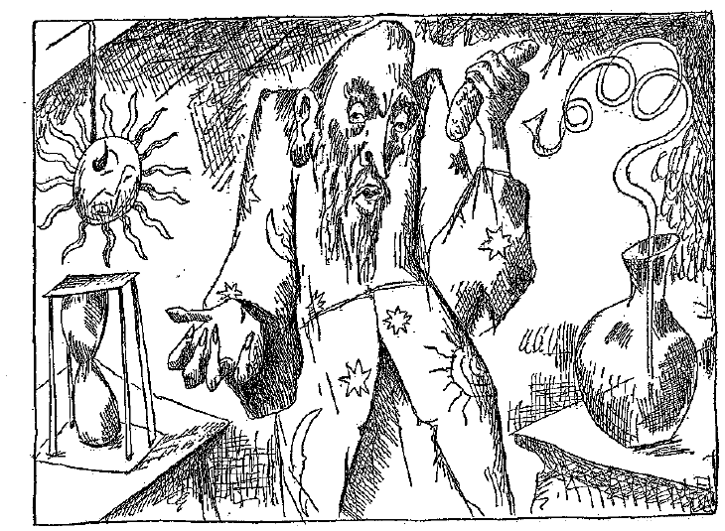
The Grand Academy of Lagado
“He had been Eight Years upon a Project for extracting Sun-Beams out of Cucumbers …”
J. Swift 1726

Slide 7

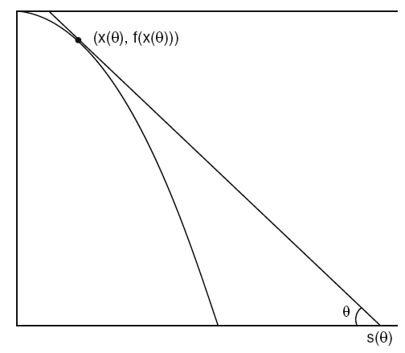



Slide 8






Add some low amplitude noise :
Another way to look at it:

Slide 9







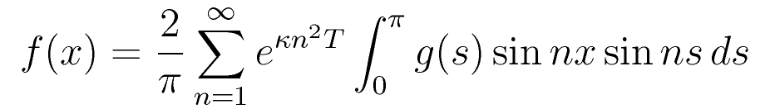
Direct:
Super Smooth

Slide 10


DEBLURRING AS AN I.P.
IMAGE
OBJECT
The Perfect Imager:

Slide 11
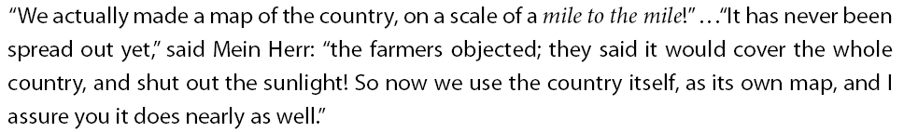


Slide 12





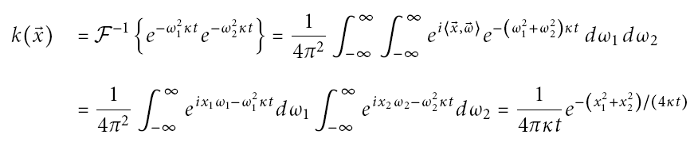
Imaging as Reverse Diffusion

Slide 13
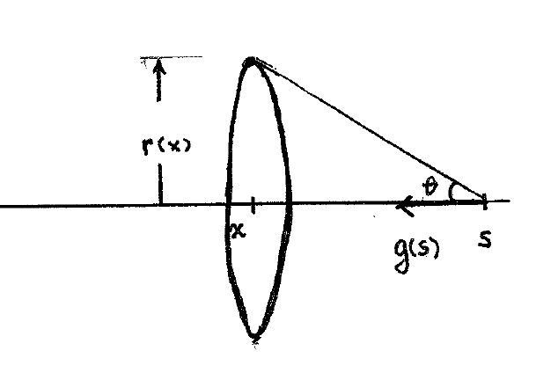



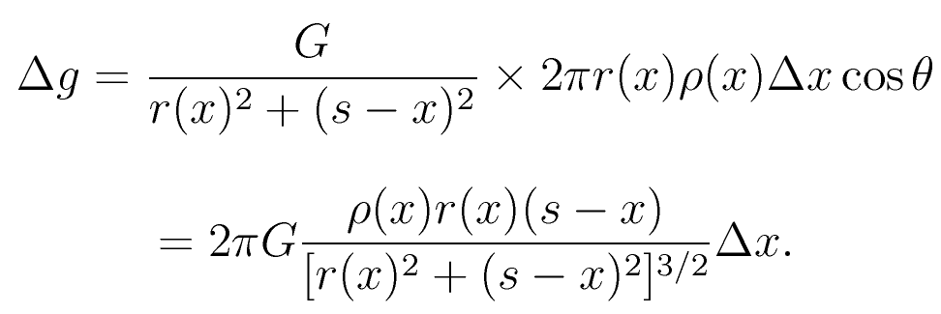
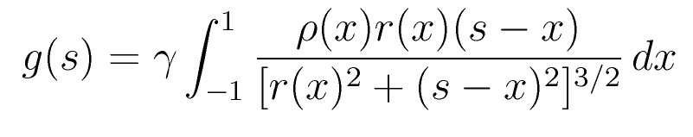
Axial Attraction

Slide 14
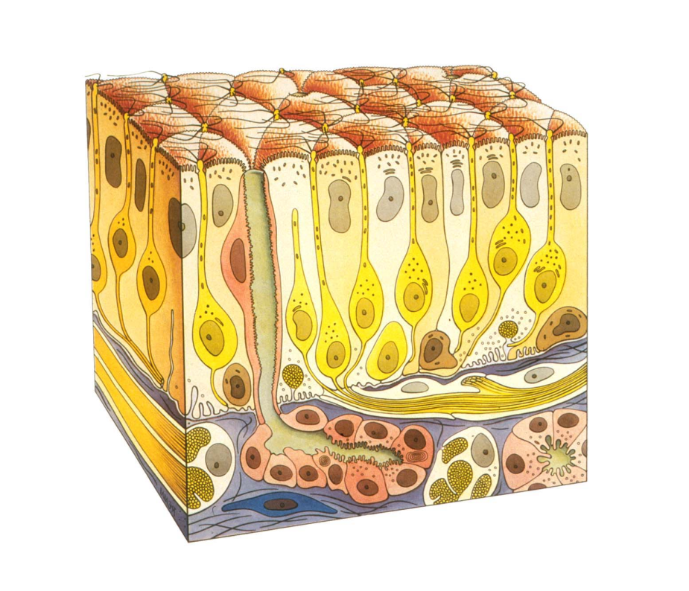
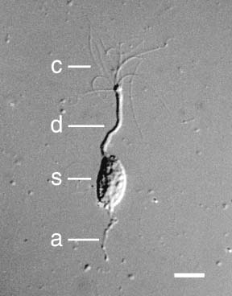
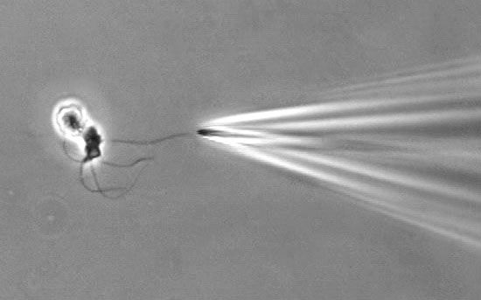
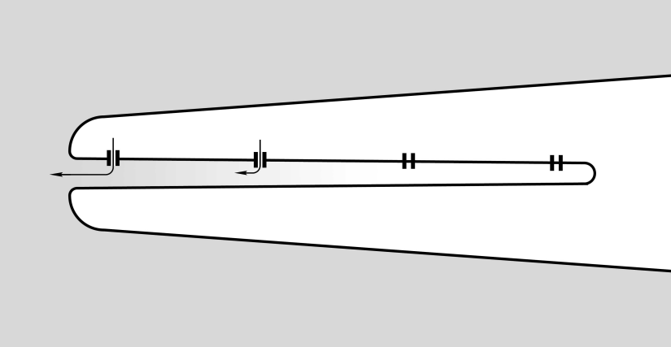
Ion Channel Distribution in Olfactory Cilia

Slide 15
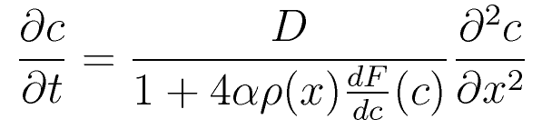
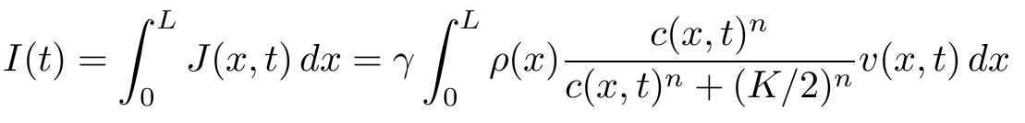
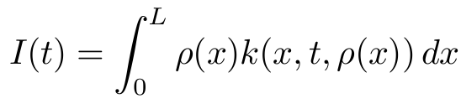

Slide 16


Framework for Inverse Problems
MODEL
CAUSE
EFFECT
K
PHENOMENON
OBSERVATION
PROCESS

Slide 17
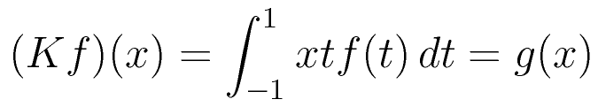



WELL-POSEDNESS: Jacques Hadamard 1902

Slide 18













The Moore-Penrose Inverse

Slide 19






Compact Operators
Linear Measurement Theory
Object
Observation

Slide 20

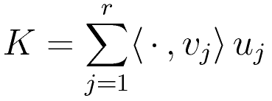

Weak Convergence
Finite Rank Operator
F.R. Operators honor weak convergence:
Compact Operators:
(Uniform) Limits of F.R. Operators

Slide 21

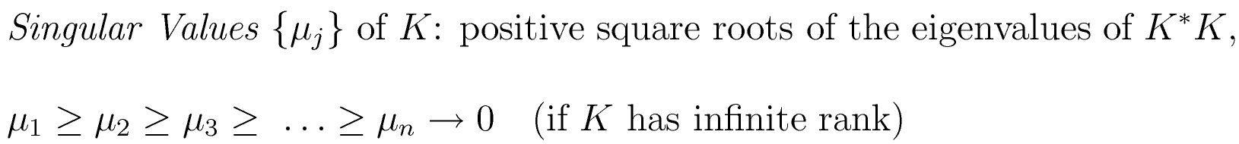
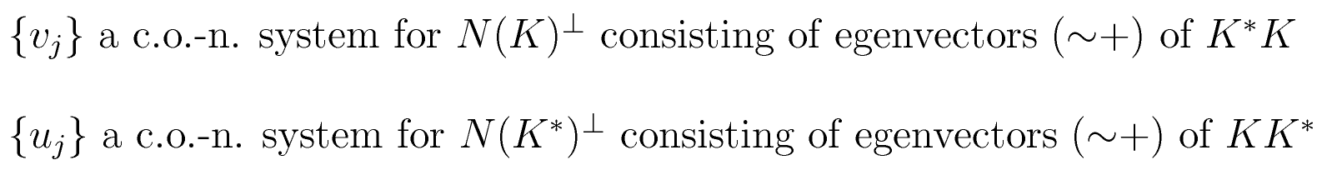

SVD: SINGULAR VALUE DECOMPOSITION

Slide 22


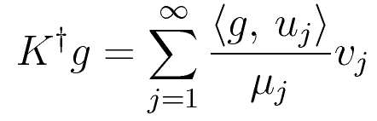
SVD & M-P Inverse

Slide 23
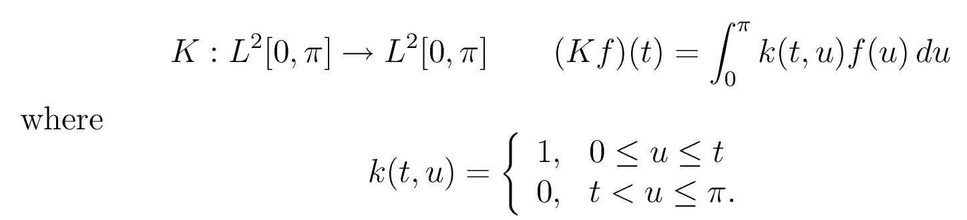
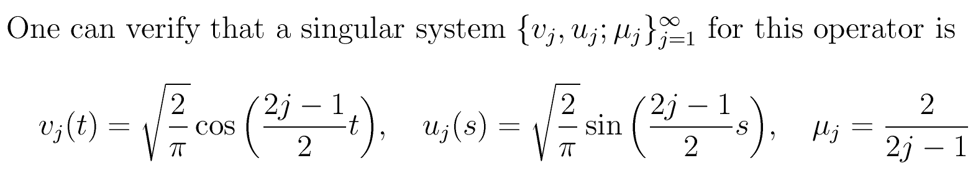
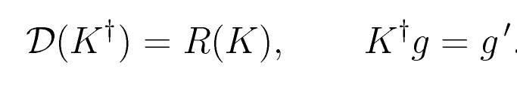
A SIMPLE EXAMPLE

Slide 24
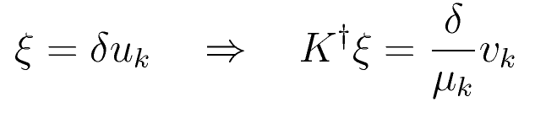
Instability

Slide 25
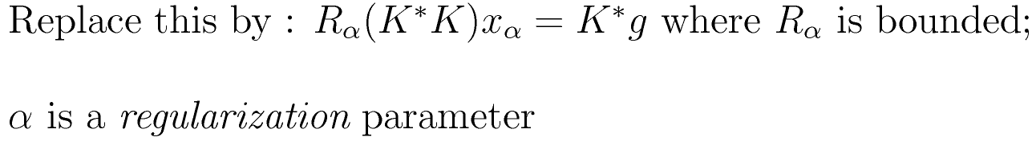



REGULARIZATION

